Slide 1
“From Electric ham and scuba monkeys” to the 6 C’s of motivation

Slide 2
Welcome
William R Cox
  SC History
  Pro-Team
  Georgetown County School District

Slide 3
Agenda
Introduction and background
Student Engagement/Motivation
Electric Ham and Scuba Monkeys … (and the Grateful Dead)
6 C’s of Engaging Students
Bottom Line Take Away

Slide 4

Introduction and Background
First Life-Business
Teacher
Change of Careers
Teacher
Private School-College

Slide 5
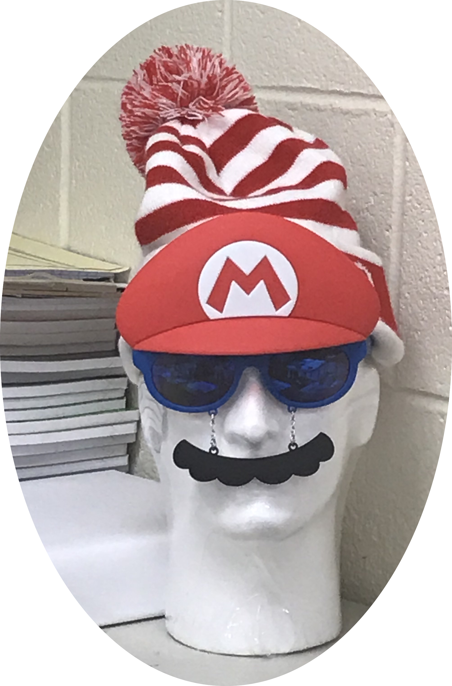
Introduction and Background
Today …
SC History and Pro-Team GCSD
Adjunct for Community College
7 Years Classroom Experience
Doctoral Candidate at USC (ABD)
Wife 2 kids 2 dogs

Slide 6
What are you and I about …
What is your philosophy of education?
Think for a minute
Turn to your neighbor and share …
Larger Group …

Slide 7
What are you and I about …
What is your philosophy of education?
  “The purpose of schooling is not to enable students to do better in school. The function of schooling is to enable them to do better in life” (Eisner, 2001).
The stakes are incredibly high for our profession …

Slide 8
Student Motivation / engagement
We often see the terms student motivation and student engagement used interchangeably … but are they?
What do you think?

Slide 9
Student Motivation / engagement
Turn to your neighbor and pair share …
Are the terms Motivation and Engagement interchangeable?
Are they interconnected?

Slide 10
Student Motivation / engagement
Interconnected (Irvin, Meltzer, & Dukes 2007)
A motivated student can be unengaged with the classroom at any given moment
Motivation is broader than one classroom or one lesson.

Slide 11
Student Motivation / engagement
We control only our classrooms …
Ask yourselves …
“If your students did not have to come to your class would they?”

Slide 12
Student Motivation / engagement
We control only our classrooms …
Less than 40% of respondents to 2006 report on high school engagement indicated they went to school because of the class (Yazzie-Mintz, 2006)

Slide 13
Student Motivation / engagement
We control only our classrooms … not society…families etc.
Comments:
  Engagement is too often judged as a snapshot
  View classroom engagement in its totality
  Observation of supervisor … @10:38 student A was not engaged …

Slide 14
Student Motivation / engagement
What are we to do? How can we impact our classrooms?
Create:
  A classroom environment that fosters a positive relationship between the teacher and student (Shernoff et al., 2017)
  Learning experiences that focus on autonomy for the student (Shernoff et al., 2017).
  Scaffold academic content, cognitive skills and purposeful engagement (Tomlinson, 2014; Wiggins & McTighe, 2005)

Slide 15
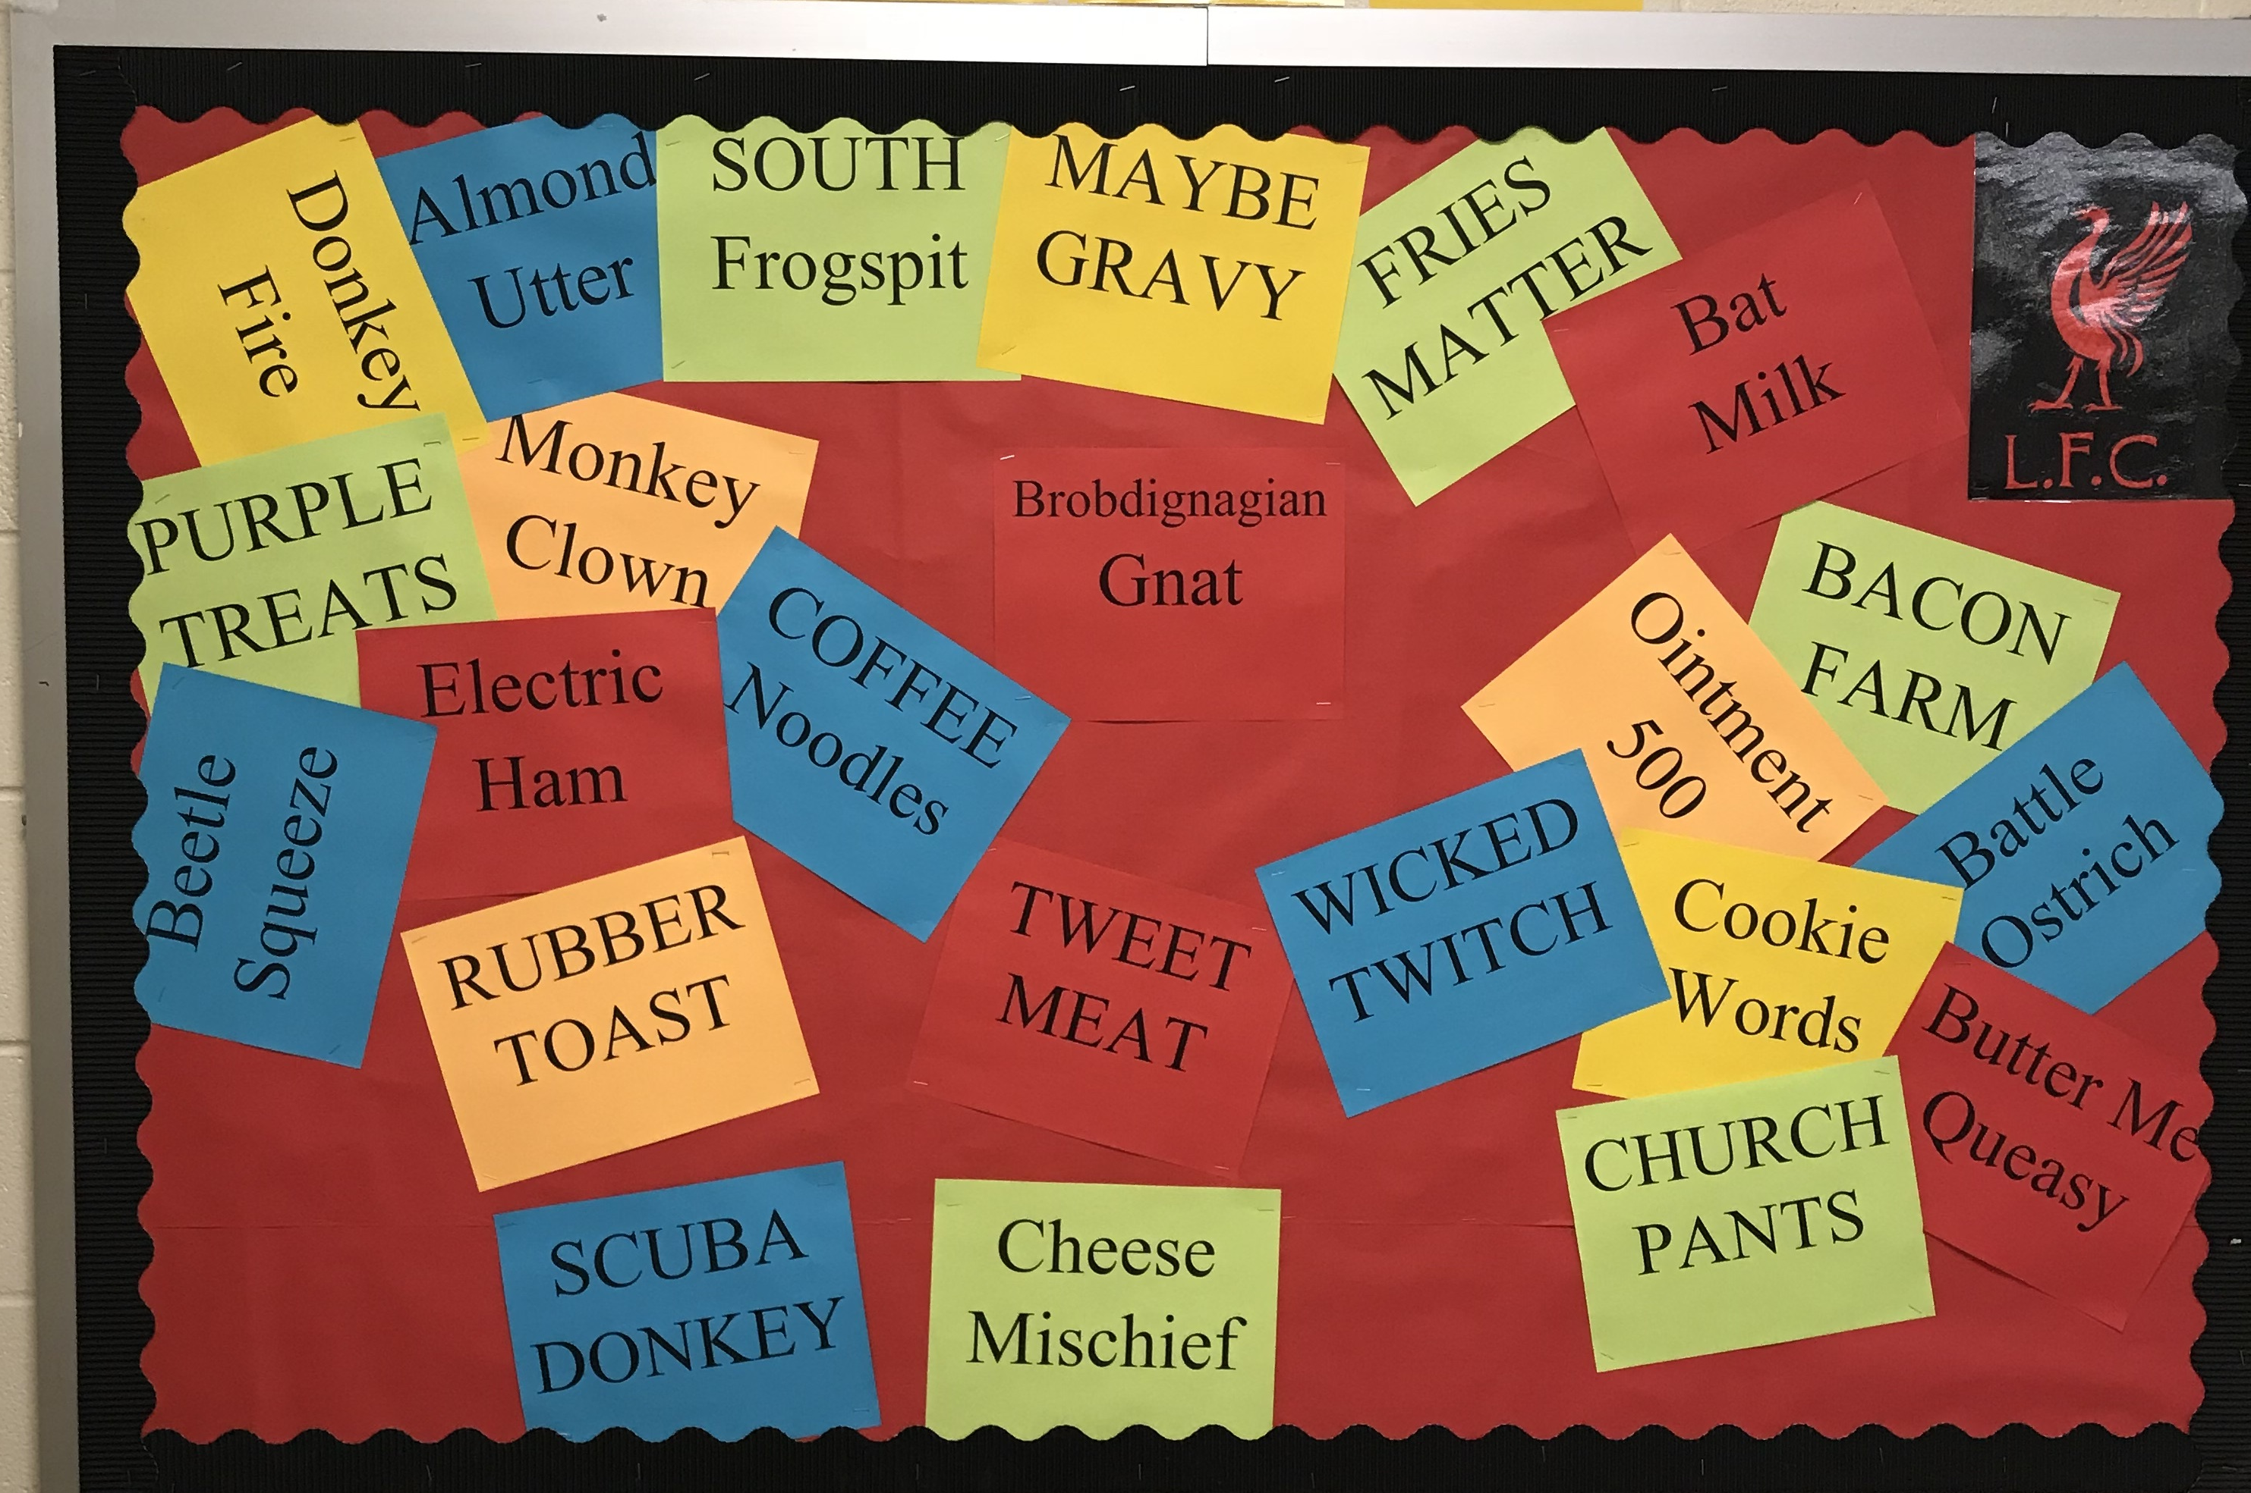
Electric Ham and Scuba Monkeys …
(and the Grateful Dead)
Create a positive relationship between teacher and student
Grateful Dead … “Truckin”
AC/DC “Highway to Hell”
Credit to my son and his soccer pals…Bat Milk

Slide 16
6 C’s (Turner & Paris 1995)
Adapted …
  Create Meaning
  Choice in Learning
  Collaborate with Peers
  Control over learning
  Challenge
  Consequences

Slide 17
6 C’s (Turner & Paris 1995)
Project based on the SC Standards for 8th grade Social Studies that surrounded the Progressive Era and WWI
Designed to implement the 6 C’s Turner and Paris developed for a literacy context
The project was completed by 118 students

Slide 18
6 C’s (Turner & Paris 1995)
Students were grouped homogeneously by Lexile levels derived from MAP scores
Allowed student of similar levels to dive as deep as they could into the project without relying on the GT kid in the group.

Slide 19
6 C’s (Turner & Paris 1995)
Create Meaning
  Students created a website based on the resources available to them on the topic.
Choice and Control in Learning
  Students were allowed to design the artifact as they saw fit.
  *Future: develop deliverables contract with students (Authentic)

Slide 20
6 C’s (Turner & Paris 1995)
Collaborate with Peers
  Homogenous grouping with peer critique on task completion/effort
  PQP Feedback (Beers & Probst, 2015)
Challenge
  Each group required different scaffolds to keep them in ZPD (Vygotsky, 1978)
Consequences
  Rubric for grading / peer assessments
  Presented to parents and community through web

Slide 21

6 C’s (Turner & Paris 1995)
Project Results:
Qualitative success
Attitude
Effort
Inquiry/curiosity
Initiative

Slide 22
6 C’s (Turner & Paris 1995)
Quantitative Results
Mean score 74%
Limited number of students got content wrong
Majority lost points for not citing sources
Many had grammatical errors

Slide 23
6 C’s (Turner & Paris 1995)
Quantitative Results
Traditional Summative Assessment followed
  Mean score 71%
Observations: students relished the autonomy to create their own artifacts and make meaning.

Slide 24
Today and the 6C’s
Each unit for course we systematically (checklist) look for the ways for students to
  Create Meaning
  Have a choice in Learning
  Collaborate with Peers
  Have some control over learning
  Challenge themselves
  Have Consequences (that are known in advance)

Slide 25
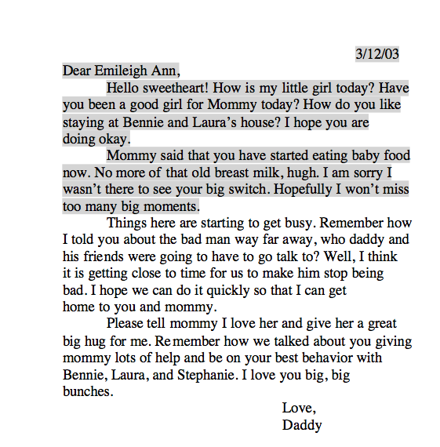
Recent thoughts
Veterans Day and Primary Source Documents
Student:
Surprises
Questions

Slide 26
Recent thoughts
Veterans Day and Primary Source Documents
  Were students engaged?
  Yes, Emotionally, Intellectually and socially in that moment!

Slide 27
Recent thoughts
Passion for your content
  We learn when our teachers are passionate about the topic/object … Animal Farm

Slide 28
Take Away
Make sure your students will come to your class even if they don’t have to …
Be intentional about positive relationships
Be intentional about the learning environment
Be intentional about engaging students … an engaged student can become a motivated student!

Slide 29
Contact
If you would like any additional information or a copy of the materials used please email me.
wcox@gcsd.k12.sc.us

