Slide 1
Fast and Easy Screencasting
...I promise!
~Ross Hill

Slide 2
Tired of...
Repeating yourself and saying the same thing twice? ;)
“Catching up” absent students?
Never enough time to cover all of the standards?
Leaving “busy work” for your students when you are absent?

Slide 3
Objectives:
Define Screencasting
Address obstacles to screencasting
Install and launch two screen recorders
Show examples of screen recordings
Brainstorm uses for your classroom

Slide 4
What is screencasting?
Recording your computer screen , voice and face.

Slide 5
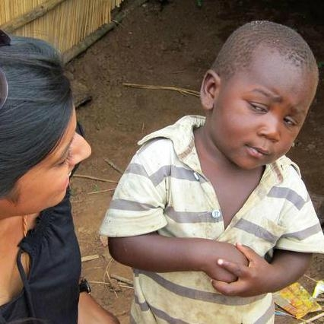
Hang ups...
“I don’t have time to change the way I teach!”
“I don’t have time to learn something new!”
“How much does this cost?”
“Will students actually watch them?”

Slide 6
Getting Started
Screencastify
>Use Google Chrome >Chrome Web Store >Screencastify

Slide 7
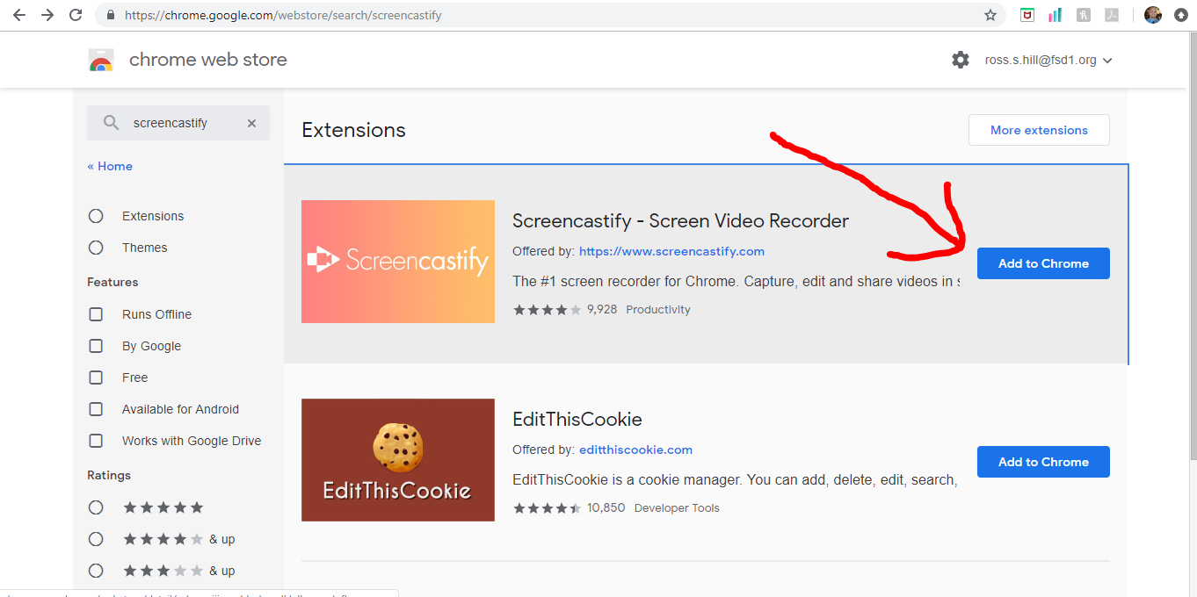

Slide 8
Getting Started
Screencast-O-Matic
>Use Google Chrome >Chrome Webstore >Screencast-O-Matic

Slide 9
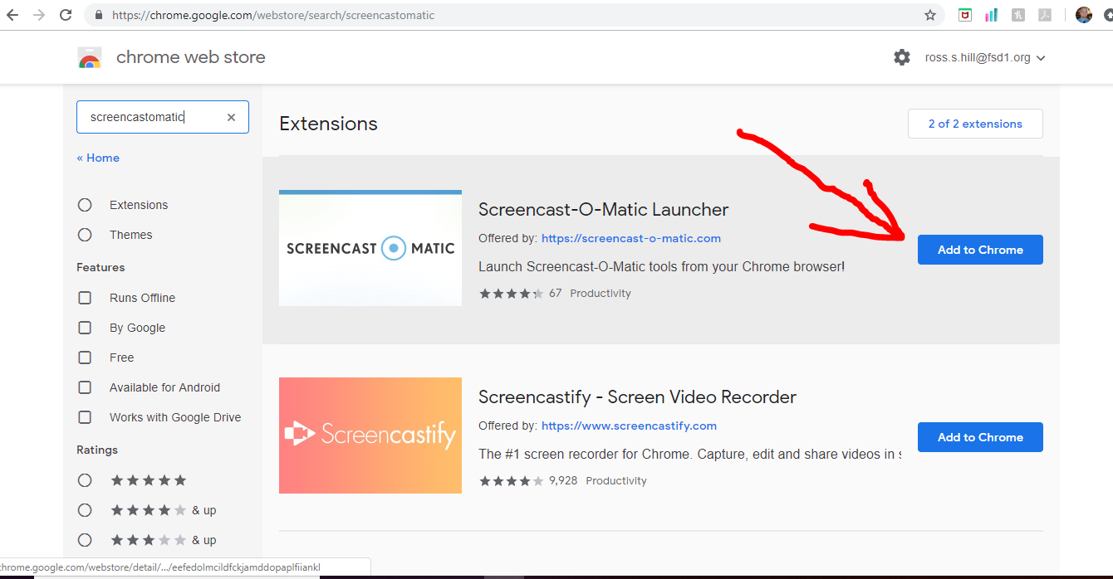

Slide 10
Disclaimer
***District or school filters and firewalls may prevent you from installing Screencast-O-Matic.***

Slide 11
 | Screen-Cast-O-Matic | Screencastify
Price | Free | Free
Launching | Launches from website or Chrome Extension | Launches as a Google Chrome Extension
Install Time | Less than 1 minute | Less than 2 minutes
Video Length | 15 minutes | 10 minutes
Number of recordings | Unlimited | 50 per month
Downloading Time | Fast | Fast
Downloads to... | Directly to computer, Youtube, or Google Drive | Directly to computer, Youtube or Google Drive
Drawing Tools | None | Draw and highlight

Slide 12
Video Lesson

Slide 13
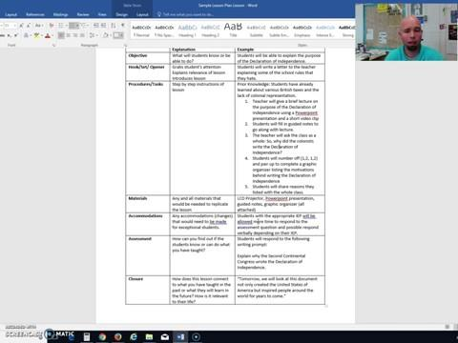
Explicit Directions

Slide 14
Think, Pair, Share
How can you envision using this in your classroom?

Slide 15
How can you envision using this in your classroom?
Lesson videos
Sub Lessons
Explain with Paper
Explicit Directions
Teach Routines
Assessments
Narrate Revisions
Peer Feedback
Narrate Tests
Record Interviews
Teach Grammar
Oral Research Paper
Math- Show your work
Open House Rewind
Upload to EdPuzzle
Practice Languages
Virtual Museum Trips

Slide 16
Was it fast?
Was it easy?
Was it useful?

Slide 17
QUESTIONS?

Slide 18
Thank you for coming!
Please fill out a paper feedback form.
ross.s.hill@fsd1.org

