Slide 1
Read-alouds
To teach cross-curricular connections
Carol S. Jackson
Dutch Fork High School, Irmo, SC
cjackson@lexrich5.org ~ @mrsjacksondfhs (twitter)

Slide 2
http://tinyurl.com/readaloudgiveaway
Register to win a book!

Slide 3
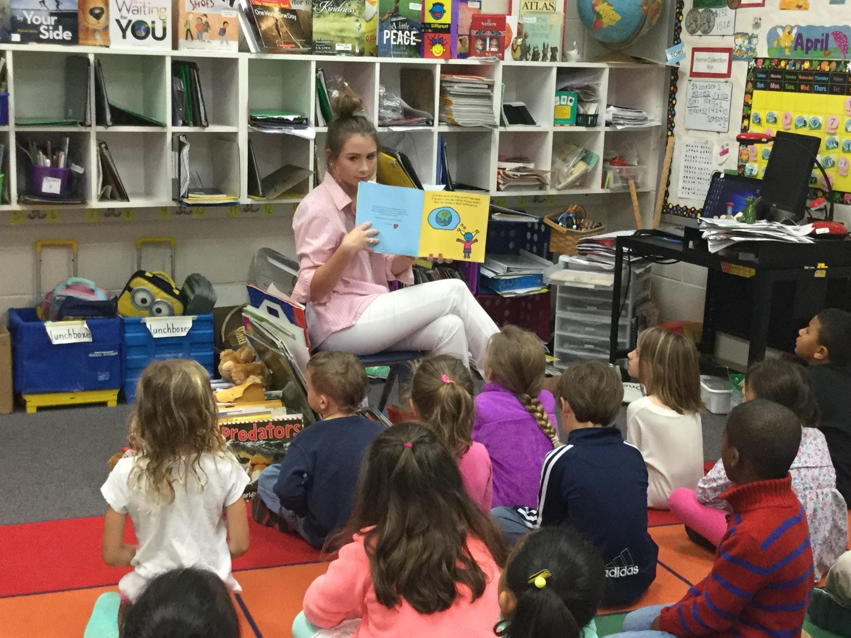
“Every good class begins with a read-aloud.” - Janet Allen
Organize
Record titles & authors
Discussion -
“What lessons can you tie into this book?”

Slide 4
What the experts say about read-alouds:
“The single most important activity for building the knowledge required for eventual success in reading is reading aloud to children.”
― Jim Trelease, The Read-Aloud Handbook

Slide 5
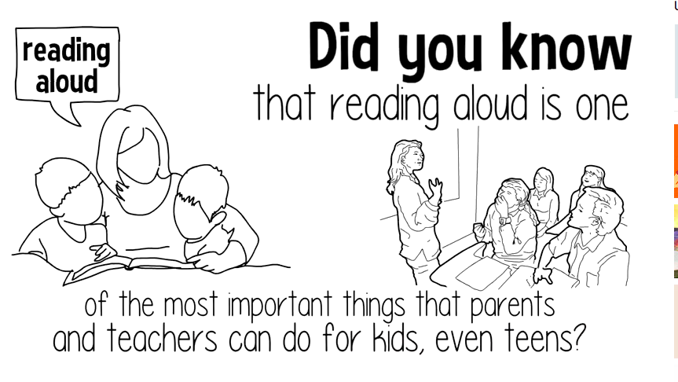
Why should teachers read aloud to students?

Slide 6
The Process...
Students sign up for R-A dates with a friend “on deck” (“OD”)
Student selects book either from classroom library or their own.
Student reads book to class, then explains why he chose book.
Students leads discussion on how book can be used in other lessons.

Slide 7
What does it look like?

Slide 8
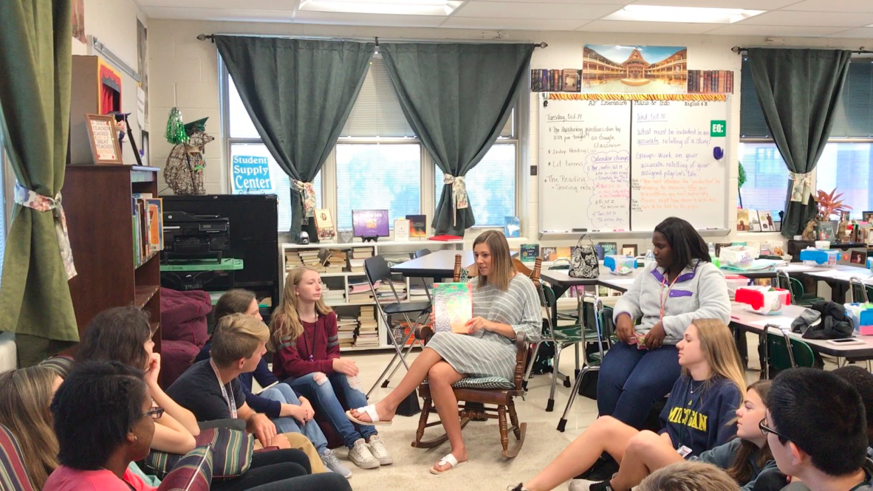

Slide 9
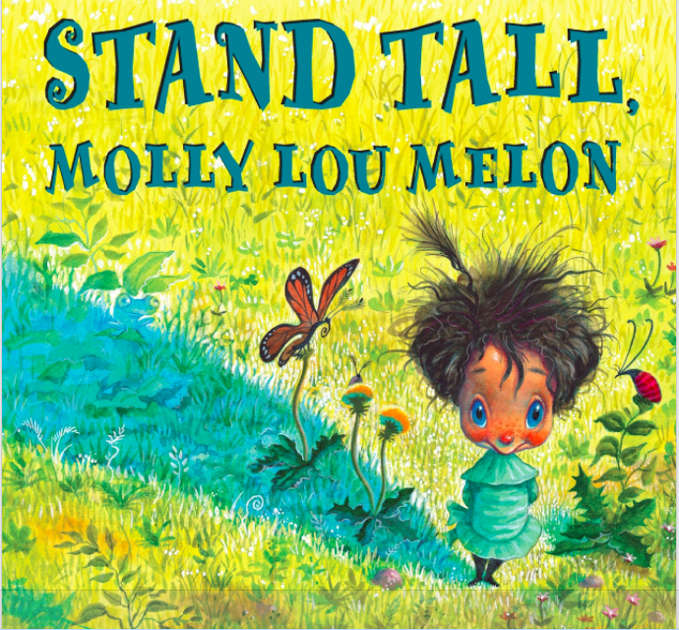
Or, it could look like this...
Notes:
Click out to the slideshow of photos

Slide 10
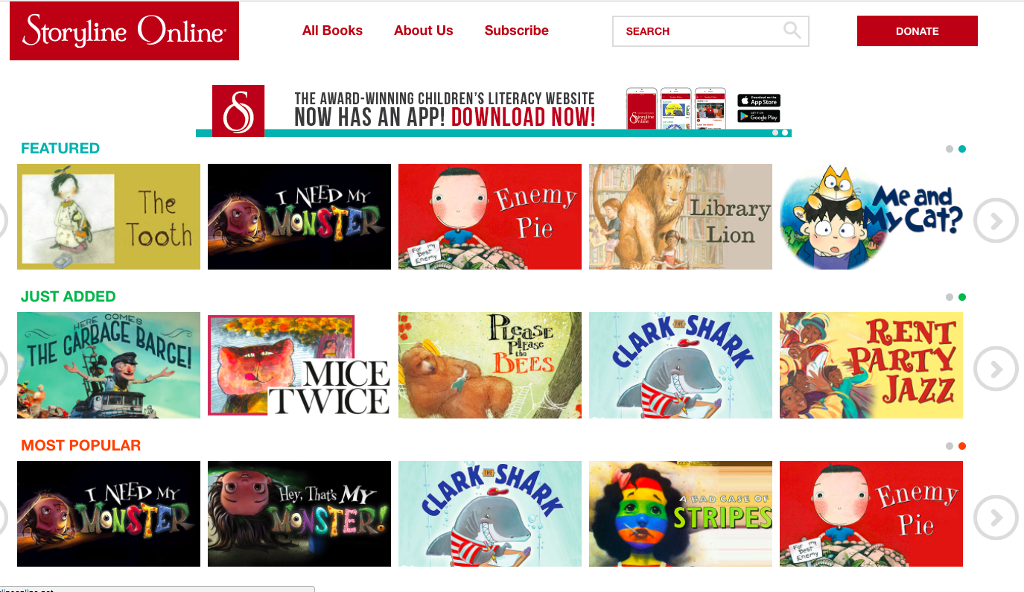
Online resources for read-alouds

Slide 11
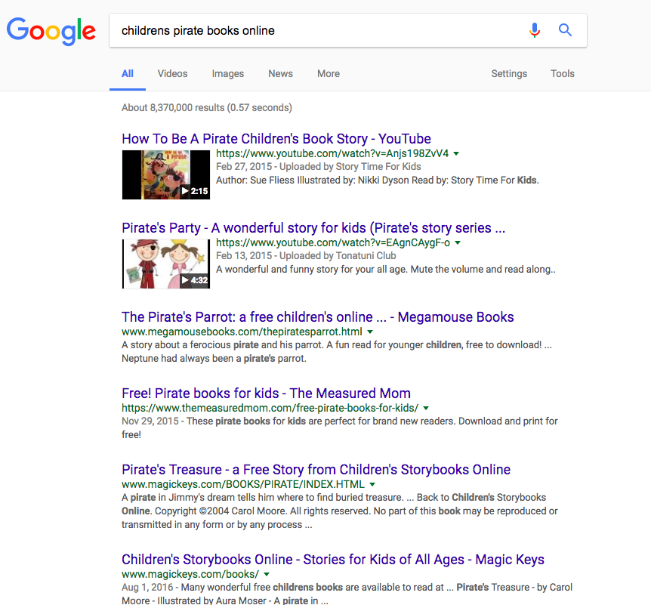
Seriously, just GOOGLE!
Talk Like a Pirate Day - Sept 19

Slide 12
Your turn to create a read-aloud connections!
Choose a book.
Read it aloud.
Lead the discussion.

