Slide 1

The Path to Teaching Fellows

Slide 2
Overview
Mission - recruit talented high school seniors into the teaching profession and help them develop leadership qualities
Fellowship not scholarship
$24,000 = 4 years of service

Slide 3

Application
Orientation
Awards
Interview Day

Slide 4
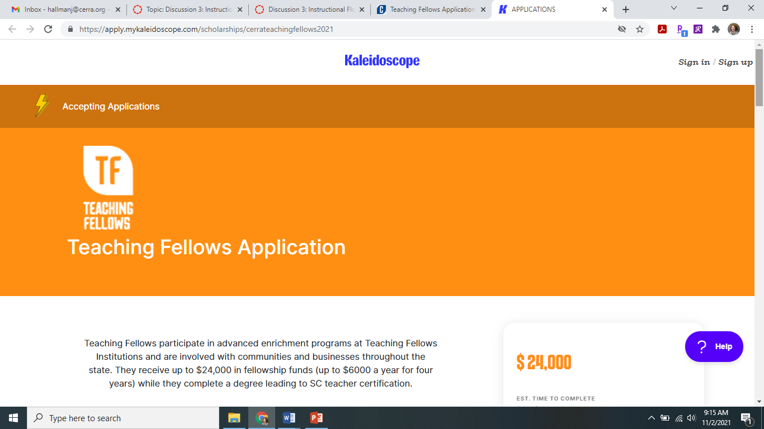

Slide 5
Application
7. Employment history
8. Add your school counselor.
9. Add two contacts to
serve as references.
10. Almost Done!
11. Agreement
1. Let's get to know you!
2. Eligibility
3. Additional Information
4. Tell us a bit about your high school.
5. School and Community Involvement
6. Awards or Recognitions

Slide 6
Regional Interview Day – February 26th
5 hundred students invited
4 regional sites
3 member interview team
2 parts to the interview
1 essay

Slide 7
Regional Interview Day – February 26th
Letter mailed to all applicants
Student Packet: FAQ, Tips, Rubric, POS, Institution Choice Form
Students MUST confirm their interview
Conflicts

Slide 8
Regional Interview Day – February 26th
Interview Criteria
  Communication
  Commitment to education
  Knowledge of educational issues
  Leadership potential
  Originality
  Problem solving
Presentation Criteria
  Ability
  Content
  Organization
  Delivery
  Knowledge of educational issues or leadership potential

Slide 9
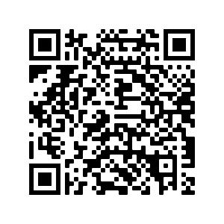







Teaching Fellows Institutions
South Carolina
UPSTATE
University of South Carolina
*Institution Choice Form*

Slide 10
Awards
Rank Order
Award
Alternate List
No Award
Waiting List
Promissory Note

Slide 11
Orientation – June 25th
Columbia area
Mandatory for TF and surety
CERRA information
TFI information

Slide 12

December 1, 2021 - Application window closes
December 3, 2021 – Supplement materials due
December 2021 - Applications scored
-
No Later Than January 10, 2022 - Letters mailed to all applicants; up to 500
students will be invited to participate in the second stage of the application process, the
interview
-
February 26, 2022 - Interview Day at regional locations across the state
-
The final number of students awarded a Teaching Fellowship is dependent upon the
South Carolina FY 2022 budget, which is set by the General Assembly.
Award notifications will be made in early spring 2022

Slide 13

Your questions?

